Slide 1
DOGGR Production Scraper Tool
Adam Reeder
Tulare HMT

Slide 2
Contents
Background / Need
Main Screen
Filters
Map / Map limits
Process Selections
File Name Appendix
Production Plots
Log-scale
Groupings
Rate / Cumulative Plots
Cumulative Production Map
Map / Map limits
Future Features
Planned

Slide 3
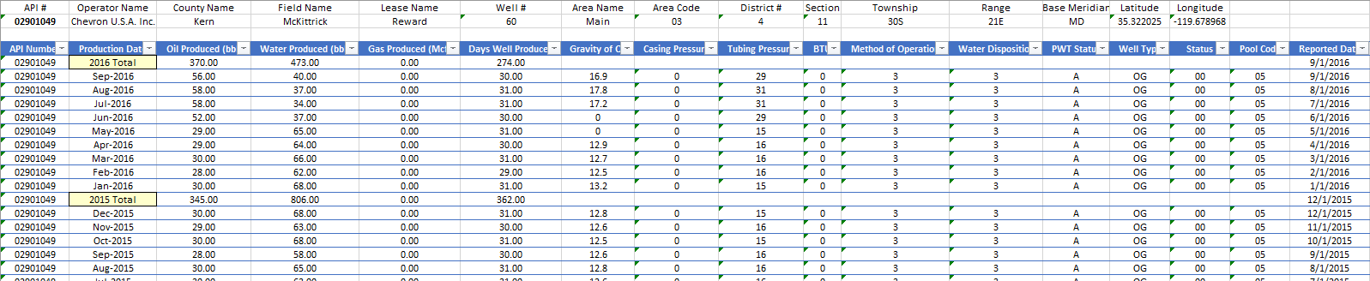
Background / Need
Desire to visually select wells from DOGGR database
Stores full DOGGR well list and updates with button click
Helpful when we don’t know API numbers
Build datasets off the DOGGR production / injection excel export API
Each queried API produces two files: one for production, one for injection
Combine the two files, determine fluid type from well type / status
Retain lat/long data from header for mapping
Generate simple plots
Export to Spotfire for further analysis

Slide 4
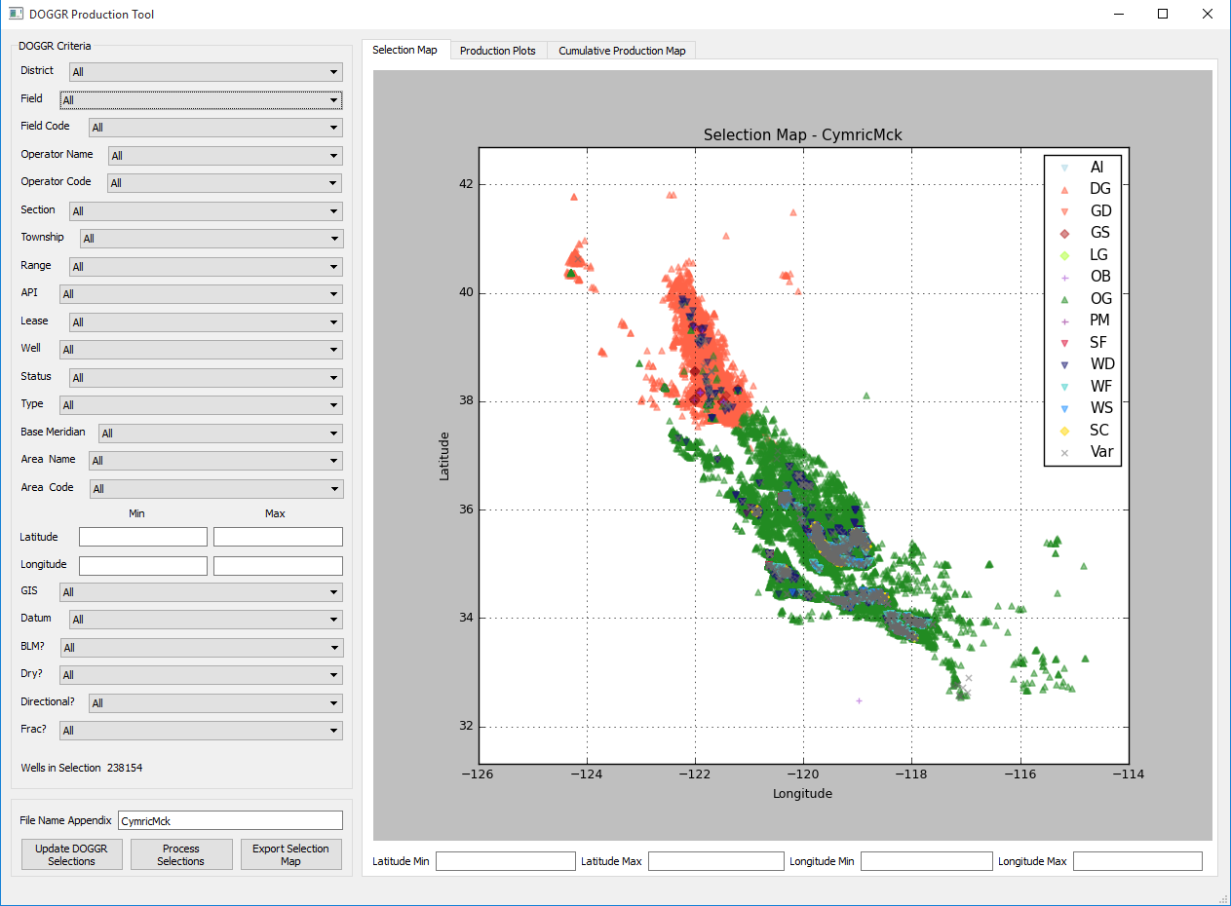
Main Screen Make well selections for processing
1. Filter to desired selections
2. Refine Map using min/max Lat/Lon
Note: Only affects map. To affect well
selection, you must transfer values to
Criteria pane on left
3. Update file name appendix

Slide 5
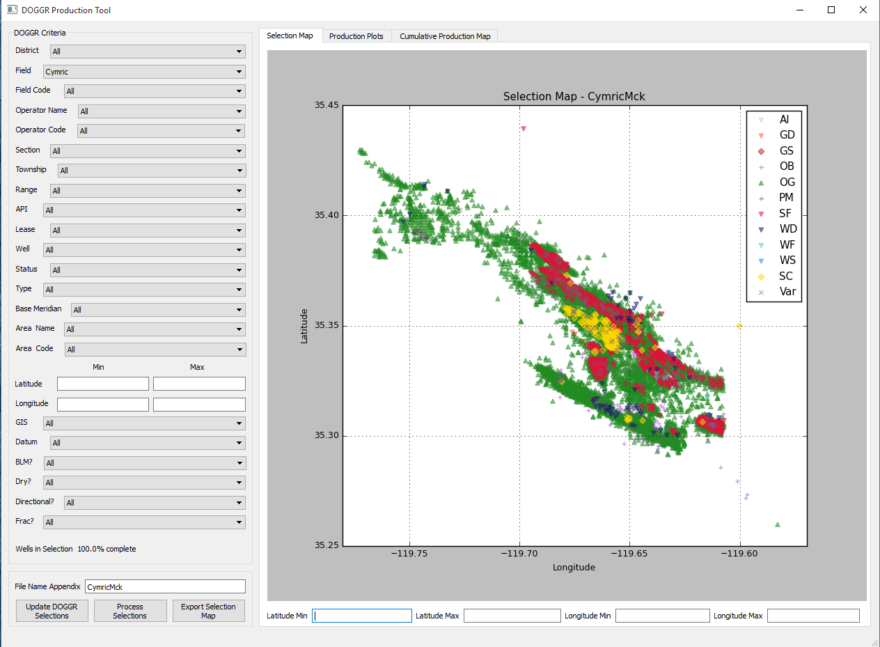
Process Selections
4. Optional: Select “Export Selections Map”
button to export map to “/plots” folder
5. Select “Process Selections” button to run
scraper program. Be patient, this takes
time to run for large selections

Slide 6
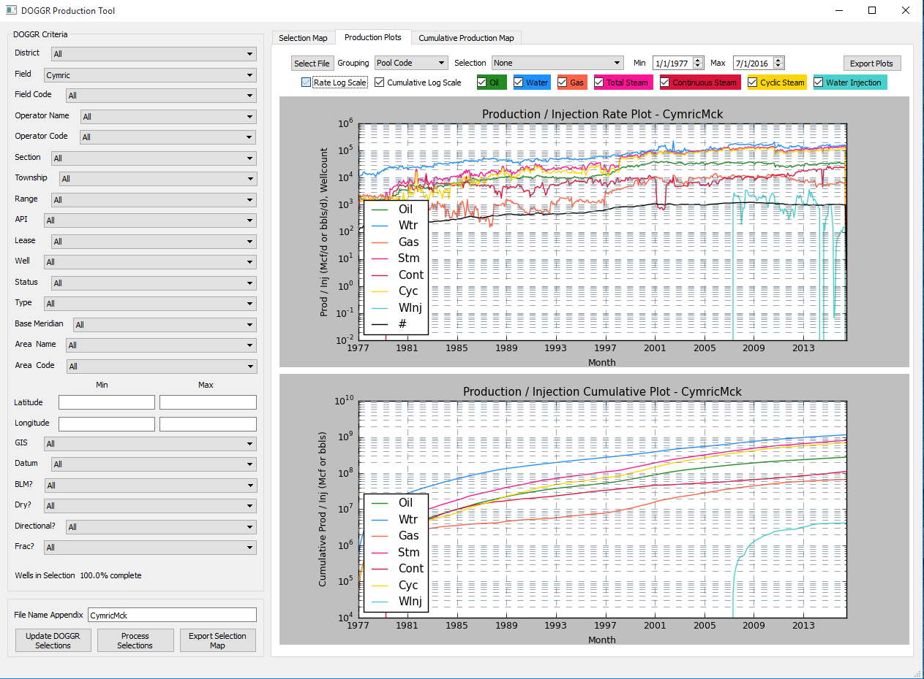
Production Plots
6. When status reads “100.0% complete”, program is done
The file will be saved to “/exports” folder as a .csv file
7. Select “Production Plots” to plot results
Note: you may need to reload the file by
choosing “Select File” and loading the .csv
8. Choose the plot data shown by checking
and unchecking product types or narrowing
the date range shown

Slide 7
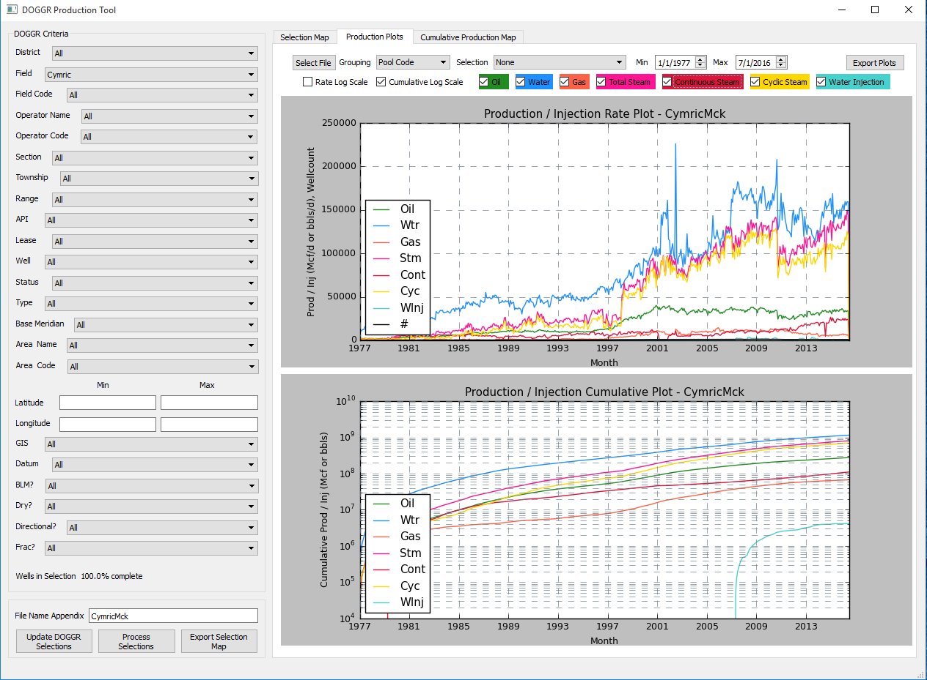
Production Plots
9. Further filter selections by choosing a
selection in “Grouping” and an available
“Selection” up top
10. Choose the preference of log scale for
rate and cumulative plots

Slide 8
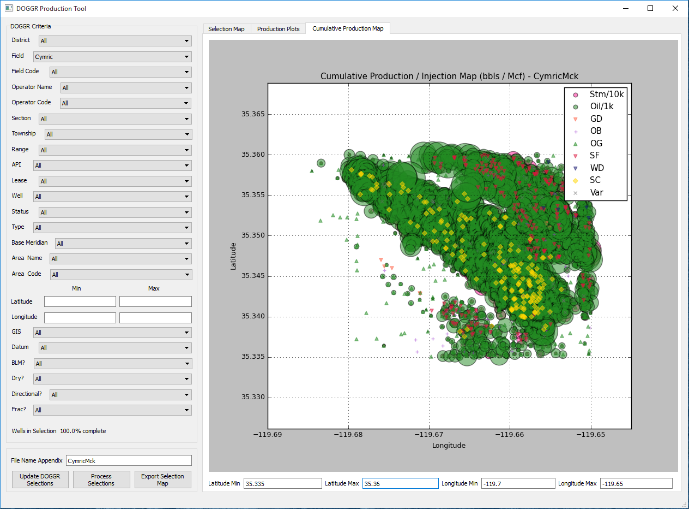
Cumulative Production Map
11. Select “Cumulative Production Map”
to display map of selected product types
12. Further refine selection using min/max Lat/Lon

Slide 9
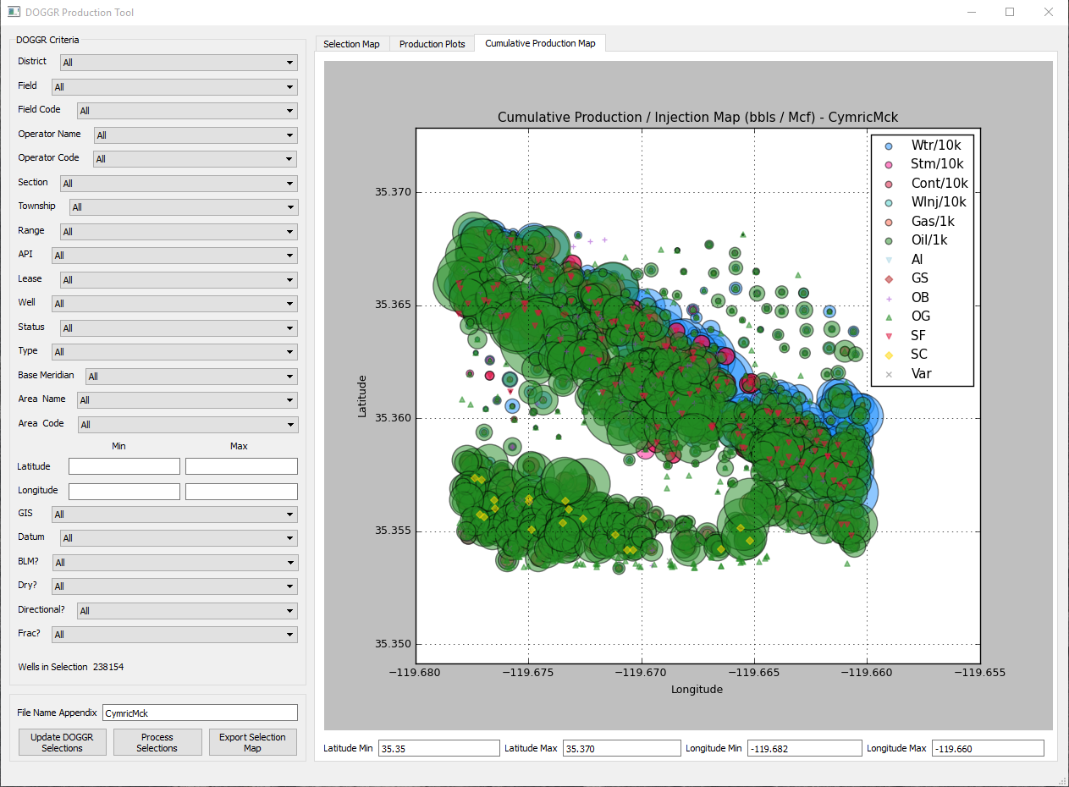
Cumulative Production Map
Note: updating min/max Lat/Lon will
update plots on “Production Plots” page

Slide 10
Production Plots
13. Choose “Export Plots” to save plots
and map to “/plots” folder

Slide 11
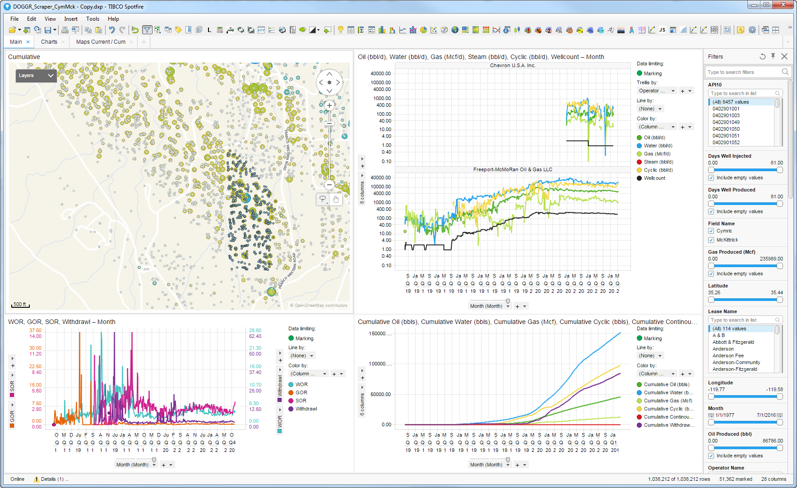
Spotfire

Slide 12
Questions?

Slide 13
Future Features
Quicker load time by not loading wells, would load form selection
All wells would be an option, after load
Ability to save well selection (API list) for easy processing in future
Would need to remember new wells may appear in geographic selections
Find way to plot current production map
Complicated by irregular reporting and difference between “Current” and “Most Recent”
Some way to automatically point the Spotfire viewer to new .csv files and create copy with same appendix?
Or maybe data file selection in single Spotfire viewer?
Suggestions?

